Slide 1
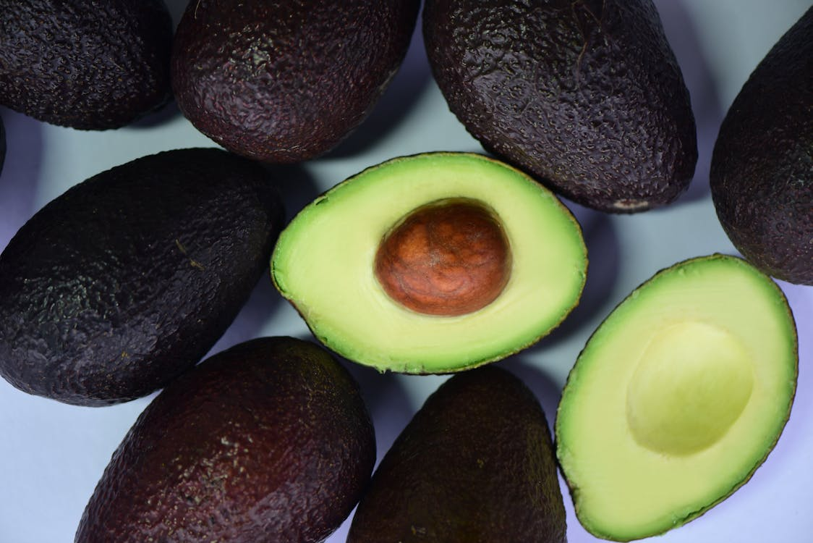
Avocado Price Analysis Dashboard
 |  |  | By Vaishnavi Darekar

Slide 2

About The Project
1. Comprehensive Data Analysis (2015-2018)
- Analyzed avocado prices from different cities across the United States, covering 18,000 rows and 13 columns of data.
- Parameters include average price, total volume, avocado type, bag sizes, year, and region.
2. Key Insights and Visualizations - Utilized pivot charts, formulas, and various visualizations to understand past and present business scenarios.
3.Interactive Dashboard
- Created an interactive dashboard Features include dynamic pivot tables, slicers, and conditional formatting for enhanced data interpretation.

Slide 3
Problem Statements:
What is the trend of average avocado prices over time?
Top 10 regions have the highest average price for avocados?
How does the total volume of avocados sold vary by type (conventional vs. organic)?
How does the average price of avocados differ by year?
What are the top 5 regions in total avocado volume sold?
What is the relationship between the average price and total volume of avocados sold?
Which month had the highest average price for avocados in 2015?
What is the total volume of avocados sold in each year?
How does the total volume of avocados sold change by type and year?
What are the trends in average price and total volume over different years?
Highest Average Price of Avocados Recorded
Total Volume of Avocados Sold in the Dataset

Slide 4
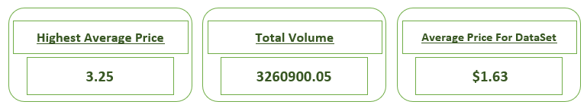
Highest Average Price of Avocados Recorded
Total Volume of Avocados Sold in the Dataset
Average Price of Avocados for the Entire Dataset

Slide 5
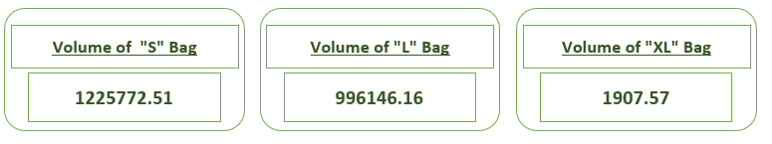
Total Volume of Small Bags Sold
Total Volume of Large Bags Sold
Total Volume of Extra-Large Bags Sold

Slide 6
What are the top 5 regions in terms of total avocado volume sold?
Conclusion: California leads in avocado sales, followed by the Northeast, SouthCentral, TotalUS, and West regions.

Slide 7
What are the trends in average price and total volume over different years?
Conclusion: The average price of avocados went up each year, but the total volume sold dropped a lot in 2018.

Slide 8
How does the total volume of avocados sold change by type and year?
Conclusion:
Conventional avocados consistently sell in much higher volumes than organic avocados across all years.

Slide 9
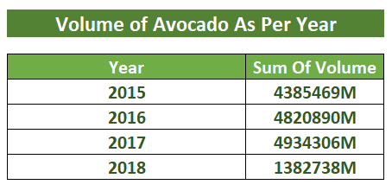
What is the total volume of avocados sold in each year? Pivot Table: Years as rows, Total Volume as values.

Slide 10
Which regions have the highest average price for avocados?
Conclusion: Harter D Springfield leads in avocado sales, followed by the San Francisco & New York

Slide 11
Conclusion: In 2015, January had the highest average avocado price.
Which month had the highest average price for avocados in 2015?

Slide 12
What is the relationship between the average price and the total volume of avocados sold?
Conclusion: The number of avocados sold goes up and down a lot, but the average price stays mostly the same.

Slide 13
How does the total volume of avocados sold vary by type (conventional vs. organic)?
Conclusion: The total volume of conventional avocados sold is much higher than the total volume of organic avocados sold.

Slide 14
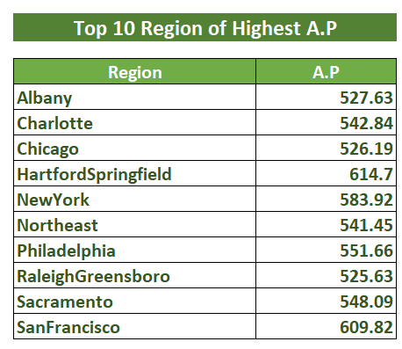
Top 10 regions have the highest average price for avocados? Pivot Table: Regions as rows, Average Price as values.

Slide 15
What is the trend of average avocado prices over time?
Conclusion: Avocado prices go up and down over time but seem to slowly decrease at the end.

Slide 16
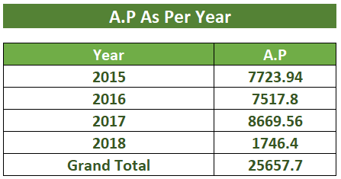
How does the average price of avocados differ by year? Pivot Table: Years as rows, Average Price as values.

Slide 17
Dashboard →

Slide 18
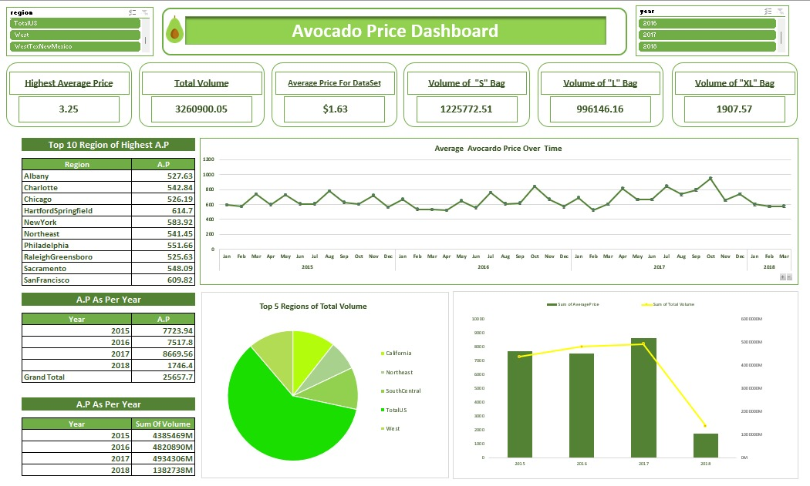

Slide 19
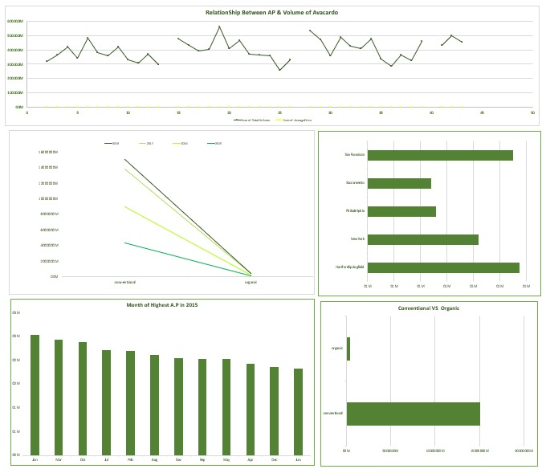

Slide 20
Conclusion:
Regional Focus: Sell more avocados in places like California and the Northeast, where demand is high all year.
Change Prices by Season: Raise prices in summer and early fall when more people buy avocados.
Types of Avocados: Keep lots of regular avocados in stock—they sell the most. Sell organic avocados in places like Hartford-Springfield and San Francisco, where people pay more for them.
Where to Sell: Sell avocados as a fancy item in places like Hartford-Springfield and San Francisco, where people pay more for them because they think they are better.
Plans for the Future: Sell more kinds of avocados, and think about selling them in new places while also selling them in places where they already sell well.

Slide 21
Project Link:
Excel:
Avocado Price Analysis Dashboard

Slide 22


